Slide 1
Busybee
We know you’re busy, so we’ll do the work to get you working.

Slide 2
Abstract
Looking for a job can be stressful
Continuously sending new applications through various platforms
Keeping track of all your pending applications
Remembering to send follow ups
Updating and tailoring resumes and cover letters
We aim to simplify the process
A single dashboard to manage all applications
Group related job applications by location, desired job title, or any other category that fits your needs
Keep copies of resumes and cover letters that you used for each application for future reference
Analyze your data to improve your job search process and land a job

Slide 3
Team
Team Member | Role | Responsibilities
Jacqueline Justice | Frontend Developer (UI/UX) | Design interface pages Develop/Style interface using React and CSS
Mason Luna | Fullstack Developer | Implement React component hierarchy Handle HTTP requests/responses
Mason Krause | Database Design/API Integration | Create entity relationship diagram Implement database schema Handle HTTP requests/responses
Jason Moss | Fullstack Developer | Javascript functionality of React components

Slide 4
Tools and Technologies
Tech Stack
Frontend
Vercel - Frontend Hosting
React.js - HTML, CSS, Javascript
HTTP
JSON
Backend
Supabase - Backend Service
Authentication
HTTP request handling
Database
Supabase - Database Hosting
PostgreSQL database
Tools
IDE
VSCode
Communication
Discord
Browser
Chrome (dev tools)

Slide 5
Login Form UI
Login Form
Page title/Header text: “Busybee Login”
App logo
Text input box for email
Password input box for password
Login button
“Forgot password?” link
“No account? Sign up for free” link

Slide 6
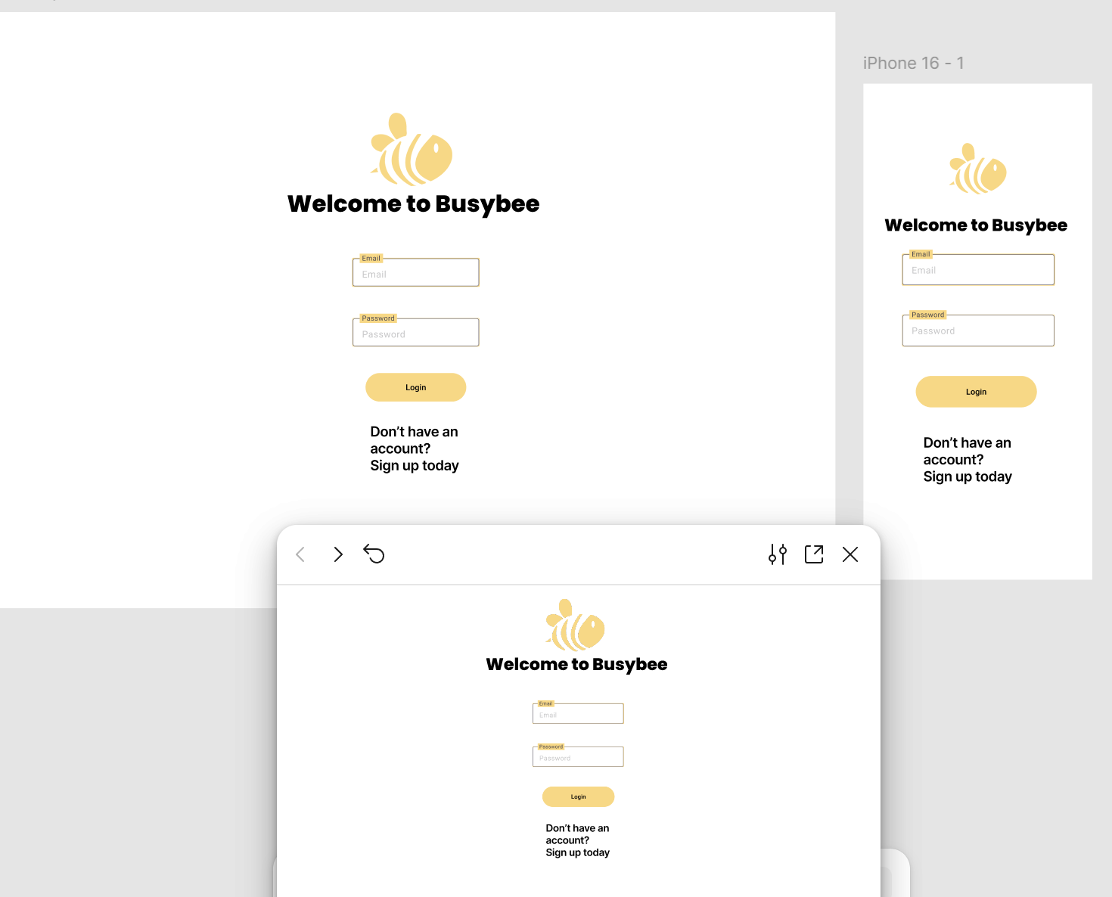
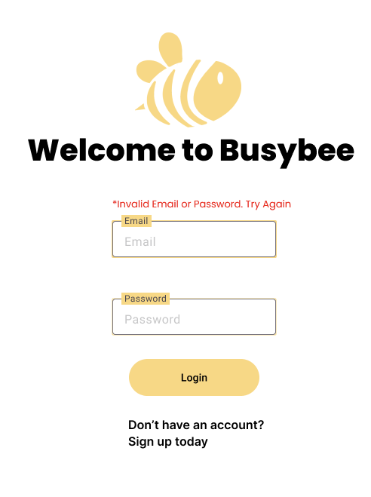

Slide 7
Login Form Functionality
Login Button
Validate input fields
Use Supabase client to send form data for authentication
Respond accordingly
User authenticated → Home dashboard, notify (“Welcome {first_name}”)
Email exists but wrong password → Login form, notify “Invalid Credentials”
No account with that email → Registration form, notify “No account found with that email”
Forgot Password Link
Present forgot password form with email input field and submit button.
Once submitted, if an account is registered with that email, a link to reset their password will be sent.
Sign Up Instead Link
Reroute to the registration form.

Slide 8
Registration Form UI
Registration Form
Page title/Header text: “Sign up for Busybee”
Text input box first name, last name
Email input box for email
Password input box for password
Password input box for confirming password
Sign up button
“Already have an account? Login instead” link

Slide 9
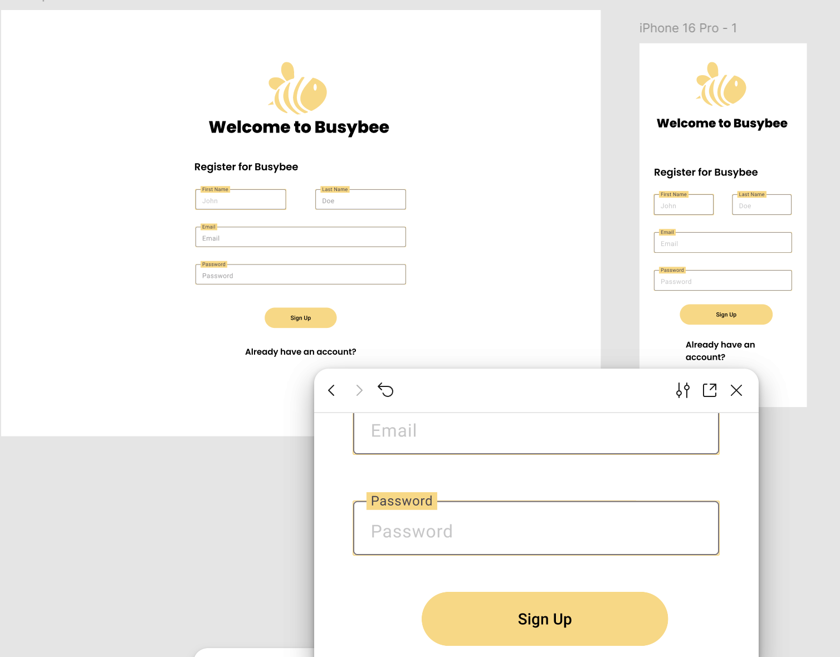
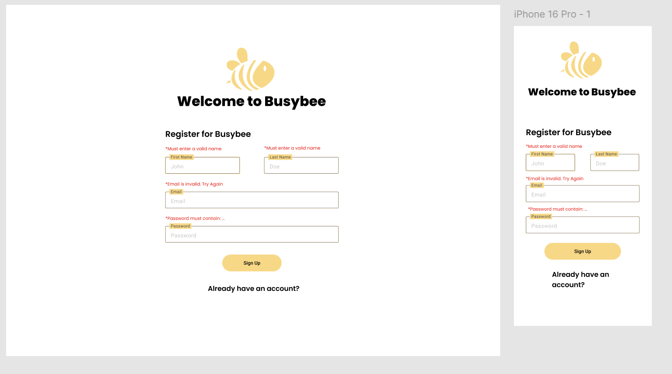

Slide 10
Registration Form Functionality
Sign Up Button
Validate input fields
Use Supabase client to send form data for new account to be created
Respond accordingly
Account created → Login form, notify “Account created successfully, please login”
Email already registered → Login form, notify “That email is already associated with an account, please login instead”
“Already have an account? Sign up instead” link
Reroute to login form

Slide 11
Dashboard UI
Header
Logo
“Welcome {name}” text
Logout button
Footer
Logo
Resources (About, Contact)
Vertical Nav
Statistics Quick View
Documents Quick View
Jobs Quick View
Groups Quick View

Slide 12
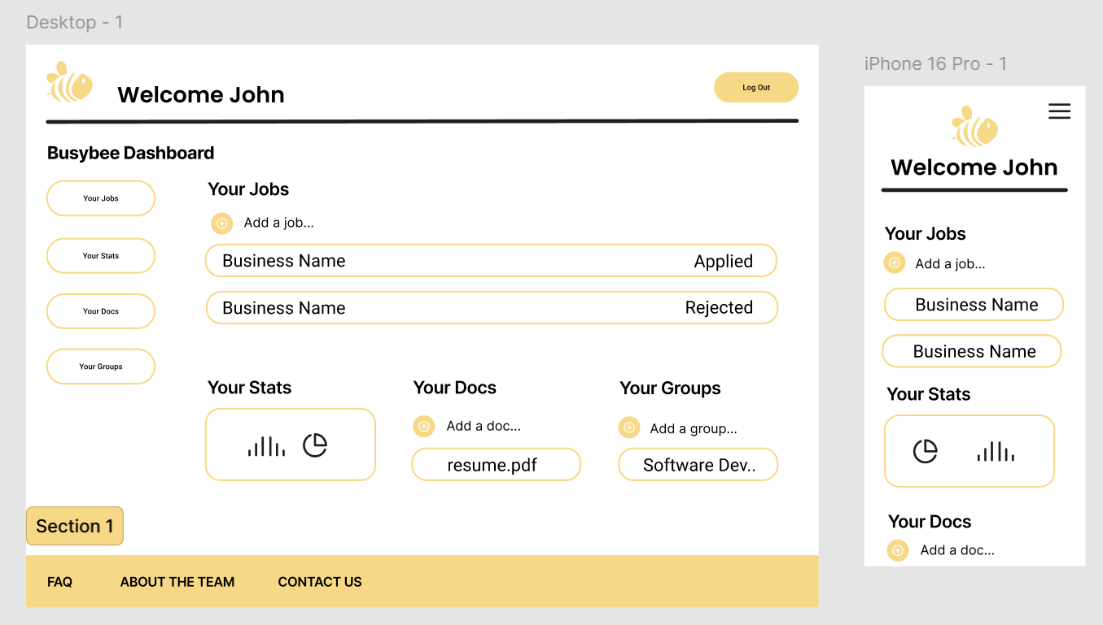

Slide 13
Dashboard Functionality
Logo → redirects a user back to the main dashboard
Logout button → uses Supabase client to send logout request
Vertical Nav → navigates between pages
Group Quick View → fetch users groups
Jobs Quick View → fetch users jobs within each group
Statistics Quick View → use jobs to calculate stats
Documents Quick View → fetch users documents from Supabase storage

Slide 14
Jobs UI
Jobs Information Section
Job count, Add job button
Jobs List
Job Popup
Edit job button, Delete job button

Slide 15
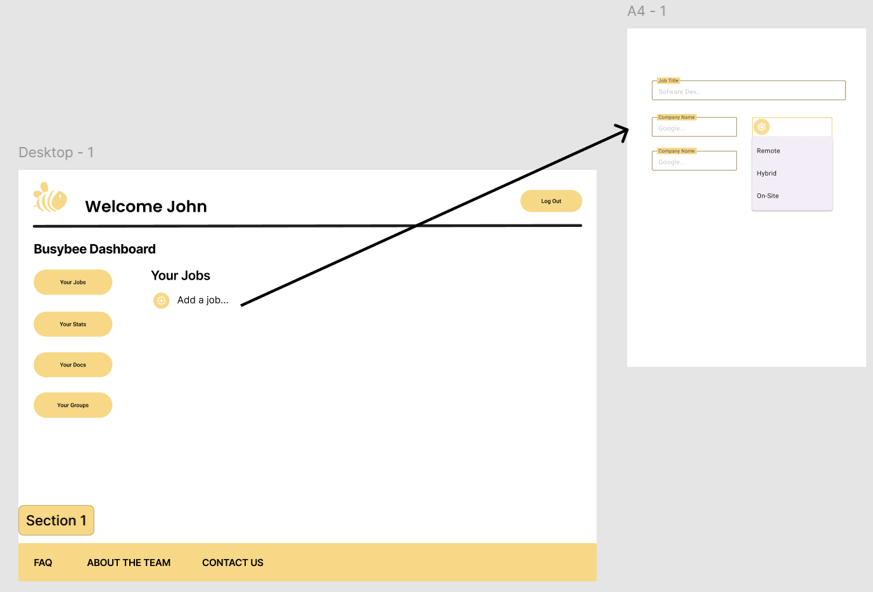

Slide 16
Jobs Functionality
Add Job
When a user saves a new job entry, the form data will be sent to the database to create the Job record. That record will be returned to the frontend to add to the users list of jobs.
Job List
Fetch users jobs for the specified group
Job Popup
Fetch job details for the selected job
Editing jobs entails sending a PUT HTTP request with the updated Job object and updating the job entry that is displayed
Deleting jobs entails sending a DELETE HTTP request for the specified Job and removing it from the list of jobs that is displayed

Slide 17
Groups UI
Group List
Add group button
Group Popup

Slide 18
Groups Functionality
Group List
Fetch a users groups and the jobs associated with them
Add Group
Send POST HTTP request with form data to create a new group
Add new group to group list
Group Popup
Fetch the details for the selected group
Editing group entails sending PUT request with updated Group object
Deleting group entails sending DELETE request for the specified Group

Slide 19
Statistics UI
Statistics Graphics
Square graphics for users statistics such as:
Total number of jobs applied to, number of applications submitted this month, average application submitted per month, application-to-interview ratio, application-to-offer ratio, and interview-to-offer ratio

Slide 20
Statistics Functionality
Statistics Calculations
When a user logs in, there statistics will be calculated and stored in browser memory.
When a user makes an update, such as changing the status of a job, or adding a new job, their statistics will be recalculated and the displayed stats will be updated.

Slide 21
Documents UI
Add Documents Button
Popup menu for user to select PDF or DOCX document
Documents List
A formatted list of the documents that a user has previously uploaded
A trash can button to delete previously uploaded documents

Slide 22
Documents Functionality
Add Documents
Document is sent to Supabase Storage using the Supabase client, the frontend will wait for the response to confirm the document was uploaded properly and display a message to confirm the successful upload or alert that there was an issue with the upload.
Documents List
Fetch all the documents a user has uploaded
Deleting documents entails sending a DELETE request to Supabase Storage for the specified document

Slide 23
Static Pages - FAQ, About us, Contact
FAQ
This page will hold some frequently asked questions and their answers.
Q: What are Groups and why should i make a group and add jobs to it?
A: A Group can be any category that is useful to your job search. You could make a group of jobs for your city, and another group of jobs nationwide for your dream title. For example, one group could be named “Clarksville” and have all the jobs you’ve applied to in Clarksville. Another group could be called “Software” and contain all the software positions that you’ve applied for, whether they are in Clarksville or not. Then you can easily look through your different groups and manage jobs.
About Us
This page will have the team members names and basic information, along with the idea for the app and the story of its creation.
Contact
This page will have some basic contact information for user feedback, questions, or concerns.

